Slide 1


PROJECT REPORT ON
DROP-RED
Submitted in partial fulfilment of the requirements for the award of the degree of
BACHELOR OF COMPUTER APPLICATIONS
Batch: 2020 - 23
Under the Guidance of Submitted By
00228402020 Aayushi Srivastava
Dr. Ruchi Sawhney 35528402020 Shweta Bisht
Bosco Technical Training Society
Don Bosco Technical School, Okhla Road, New Delhi-110025
9643868820, 8527787221, 011-41033889
Affiliated to
Guru Gobind Singh Indraprastha University, Delhi
Sector - 16C, Dwarka, New Delhi - 110078 (India)
Phone: +91-11-25302170, Fax: +91-11- 25302111
E-Mail Id: ggsipu.pr@rediffmail.com, pro@ipu.ac.in

Slide 2




DROP RED
MINOR PROJECT
Bosco Technical Training Society
Don Bosco Technical School, Okhla Road, New Delhi-110025
PRESENTED BY AAYUSHI, SHWETA
UNDER THE GUIDANCE OF
DR.RUCHI SAWHNEY

Slide 3


Table Of Contents
INTRODUCTION
TOOLS REQUIRED
SCOPE OF THE PROJECT
OBJECTIVES
USER INTERFACE DESIGN
FUTURE SCOPE/CONCLUSION

Slide 4


This project is designed to store, process and manage information concerned within blood bank.
This is design to handle the daily transaction of the blood bank and search the details when required.
Aim is to provide transparency in this field, and make the process of donating blood from blood bank hassle free.
Introduction

Slide 5

Problem Statement
Scarcity of rare blood group.
Unavailability of blood during emergency.
less awareness among people about blood donation .
Deaths due to lack of blood during operations.

Slide 6

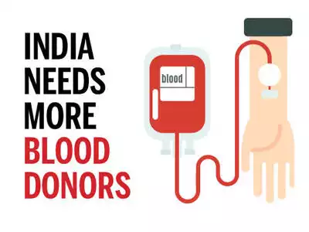

Slide 7


Existing
System
The management of data records was very poor.
.
It needed an upgradation.
Privacy is difficult to maintain and manage.
Time consuming is retiring, storing and updating the data.

Slide 8
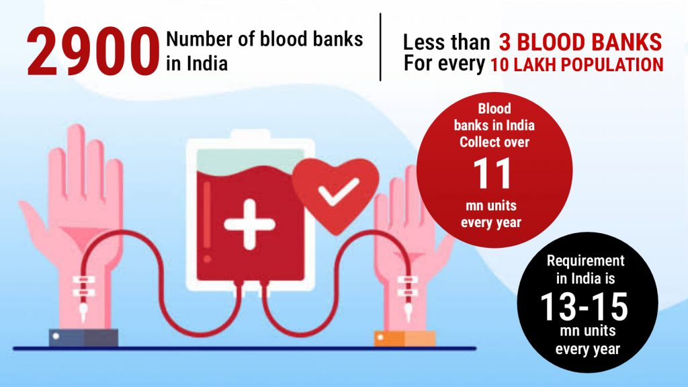


Slide 9


Objectives
The proposed system is designed to help the Blood Bank administrator to meet the demand of Blood by sending or serving the request for Blood when
required.
The main objective of this system is to maintain whole information about the donor and donation process.

Slide 10
Tools,Platform/Hardware
2.Front end
Tools
1.XAMPP Server
HTML, CSS, JavaScript
3.Back end Tools
4.Operating System
PHP, MySQL
Google chrome, internet explorer.

Slide 11
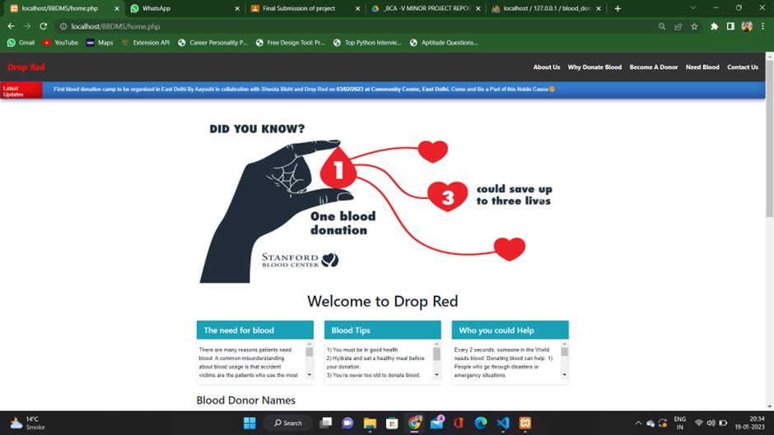
User Interface Design

Slide 12
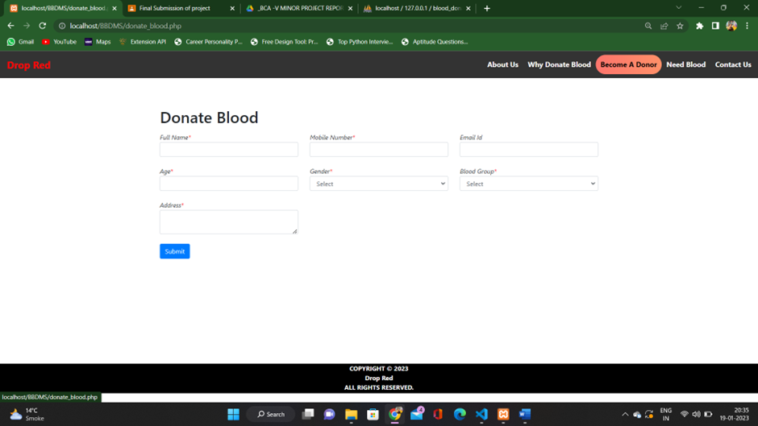

Slide 13
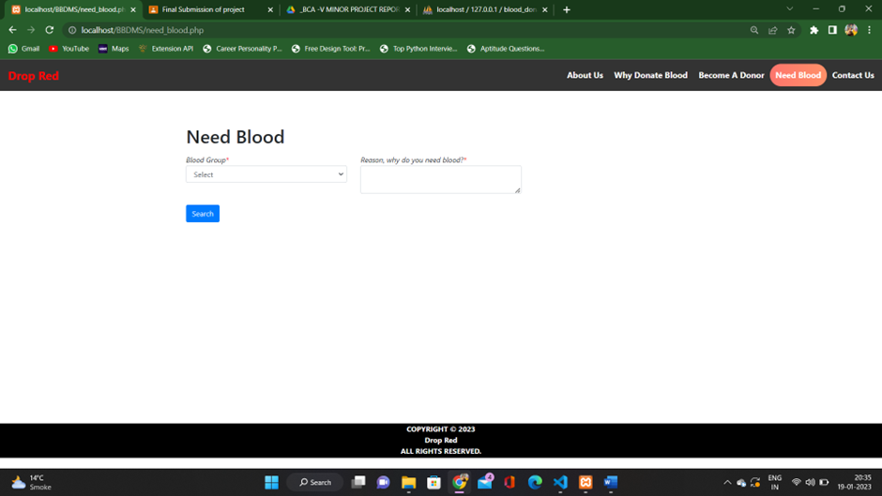

Slide 14
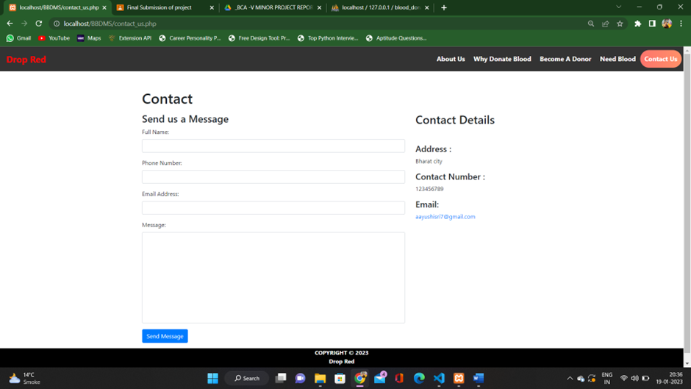

Slide 15

Future Scope of
the Project
This project can be really helpful in healthcare sector, as we know that every two seconds someone needs blood. It is essential for surgeries, cancer treatment, chronic illnesses, and traumatic injuries.
Whether a patient receives whole blood, red cells, platelets or plasma, this lifesaving care starts with one person making a generous donation.The most important thing after that is the blood which is donated is used at its best.
The improper management of the blood leads to wastage of the available blood inventory.
DROP-RED is a web-based application which is built in a way that it should suits for all type of blood banks in future.
The main future scope of this project can be the use of the available blood inventory at its best and providing the awareness about importance of blood donation to both the donor or the receiver.

Slide 16

CONCLUSION
The project helped us in gaining practical knowledge of not only programming with web-based application development but also about all management and handling that is related with “blood bank management system”.
This will provide better opportunities and guidance in future
for developing projects independently.
It gave us the requisite practical knowledge to supplement the already taught theoretical concepts, thus making us more competent as a computer student.

Slide 17



Slide 18

Thank you for listening!
DROP
RED

